Slide 1
Turtle robot

Slide 2
Parts:
1 Servo motor
2 Stepper motor
Bluethooth module
Arduino nano
Motor driver IC

Slide 3
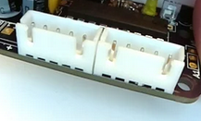
Personalized IC
JST headers for stepper motor
3 pin male headers for servo
6 pin on off stwitch
Two 15 pin female header for Arduino nano
6 pin female headers for bluethooth module
2 berg connector for batteries

Slide 4
